Slide 1
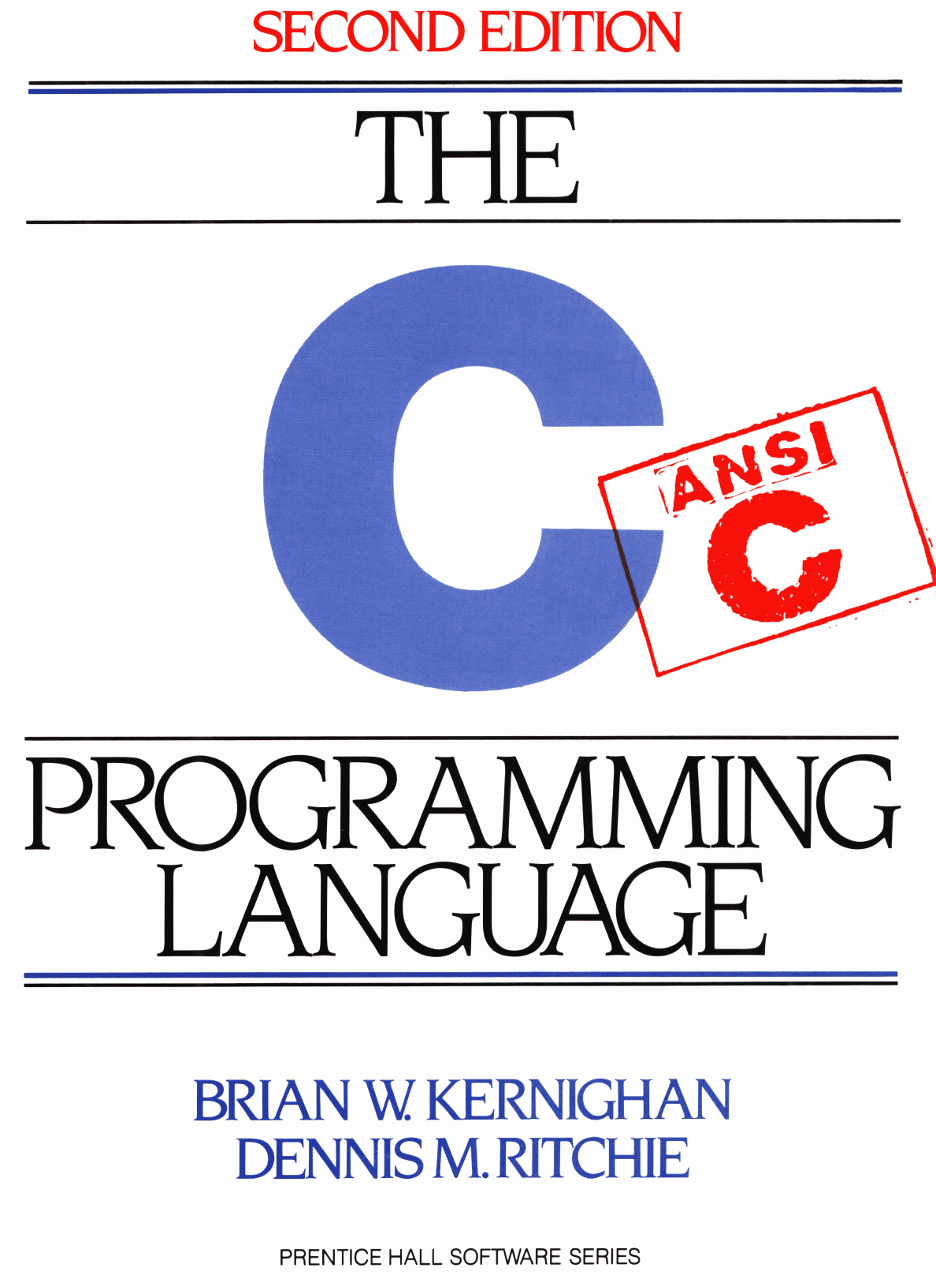
Chapter 6: Structures Kianoosh G. Boroojeni

Slide 2
Chapter Goals
To understand structures in C
To learn how to declare structures in C
To understand pointers to Structures in C
Struct: A collection of one or more variables

Slide 3
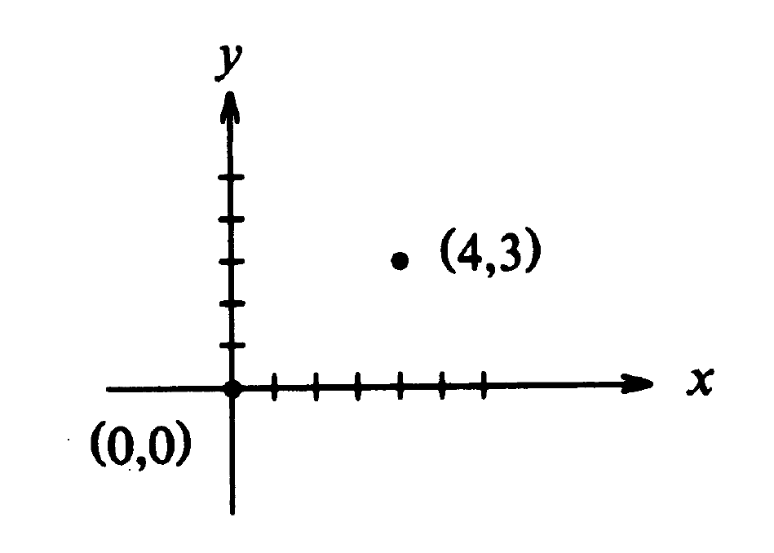
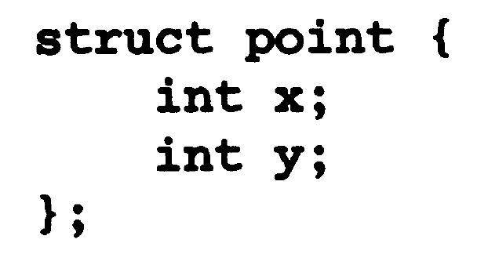
Basics of Structures

Slide 4
Basics of Structures
Declare structs:
struct point { … } x, y, z; //Define and instantiate in one line
struct point { … }; struct point x, y, z;/* Define, then instantiate */
Initialization:
struct point maxpt = {320, 300};
Access to a structure member using ‘.’ operator:
structure_name . Member
Example: maxpt . x //is equal to 320
printf(“%d, %d”, maxpt.x, maxpt.y);

Slide 5
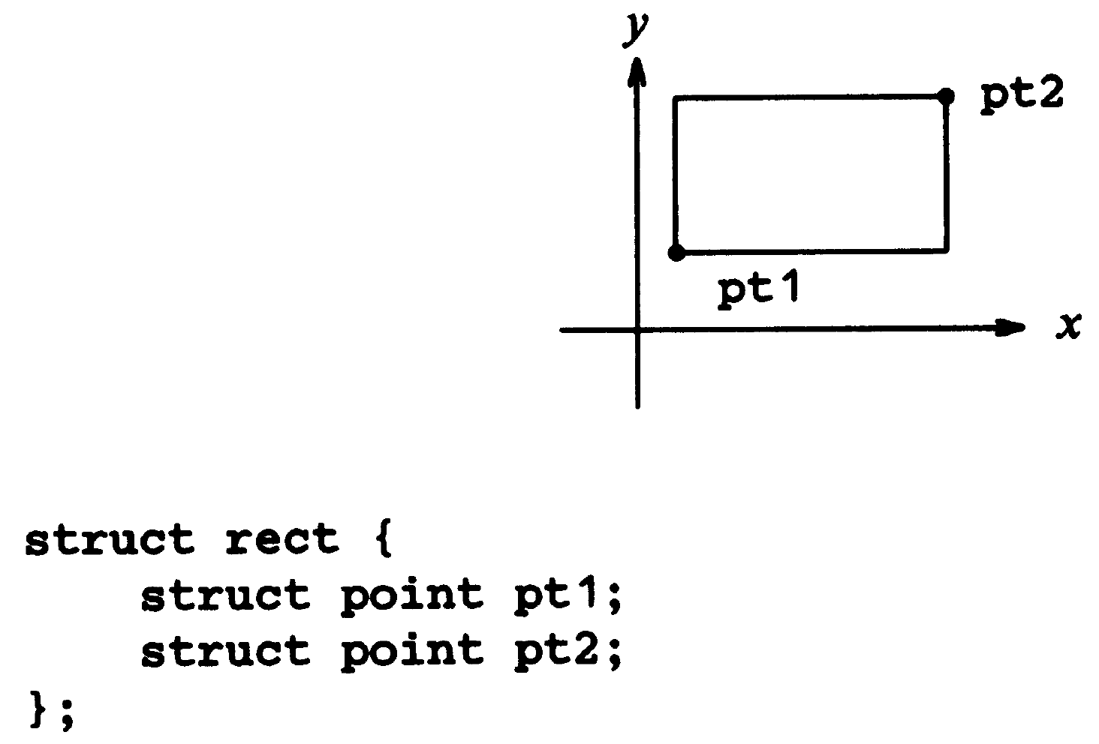
Basics of Structures

Slide 6
Basics of Structures
struct rect screen;
screen.pt1.x refers to the x coordinate of the left corner vertex of rectangle “screen”.

Slide 7
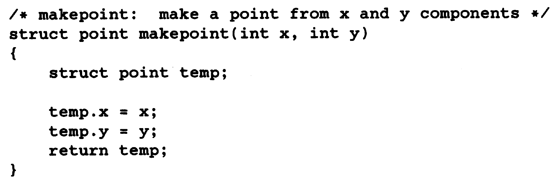
Structures and Function

Slide 8
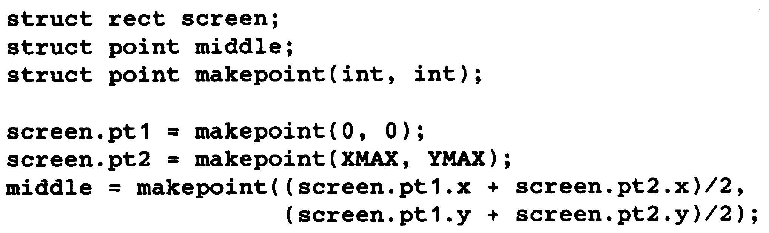
Structures and Function

Slide 9
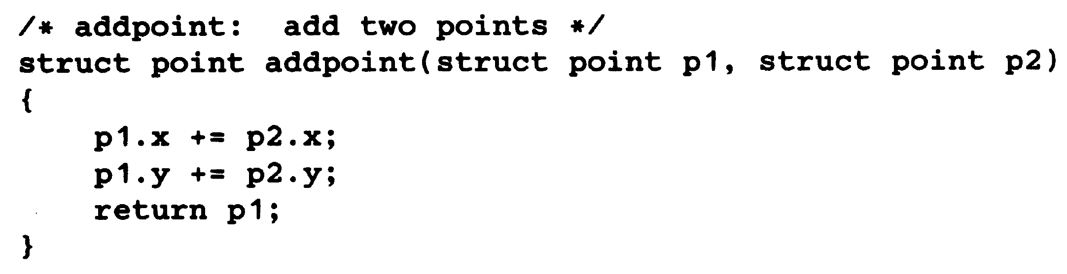
Structures and Function

Slide 10
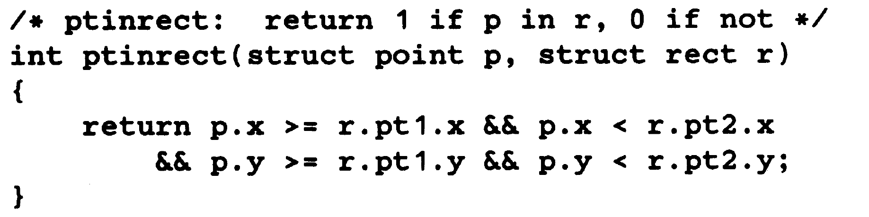
Structures and Functions

Slide 11
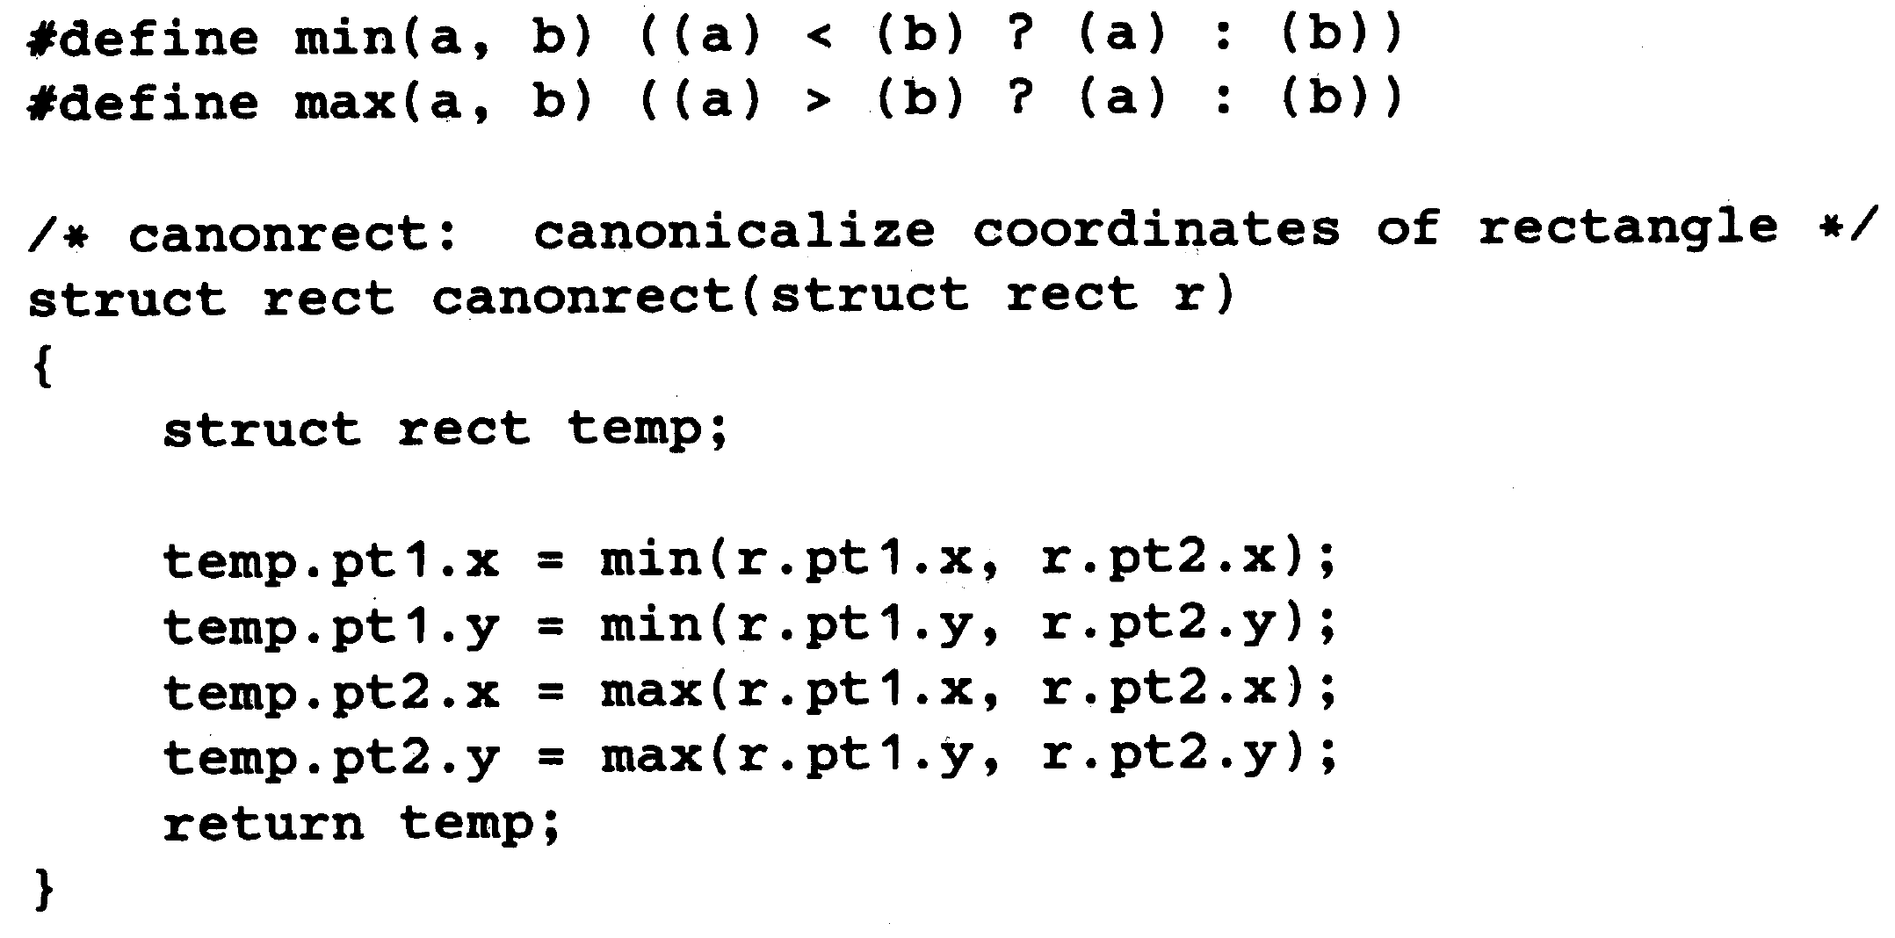
Structures and Functions

Slide 12
Pointer to Structures
struct point origin, *pp;
pp = &origin;
printf( “origin is (%d, %d)\n”, (*pp).x, (*pp).y);
Accessing a struct member through a pointer to it:
pointer -> member of struct
printf( “origin is (%d, %d)\n”, pp->x, pp->y);

Slide 13
Pointer to Structures
Both . And -> are left-associative:
struct rect r, *rp = &r;
r.pt1.x is valid and is equivalent to (r.pt1).x
rp->pt1.x is valid and is equivalent to (rp->pt1).x

Slide 14
Pointer to Structures
struct {
int len;
char *str;
} *p;
++p->len // is equivalent to ++ (p->len)

Slide 15
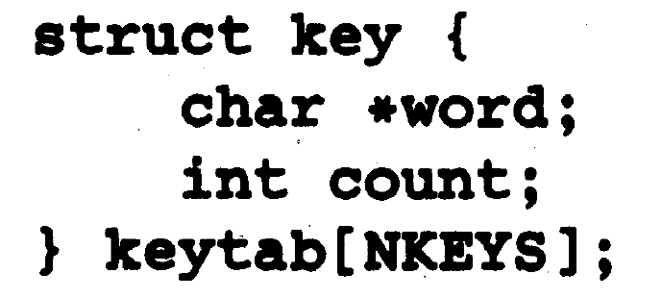
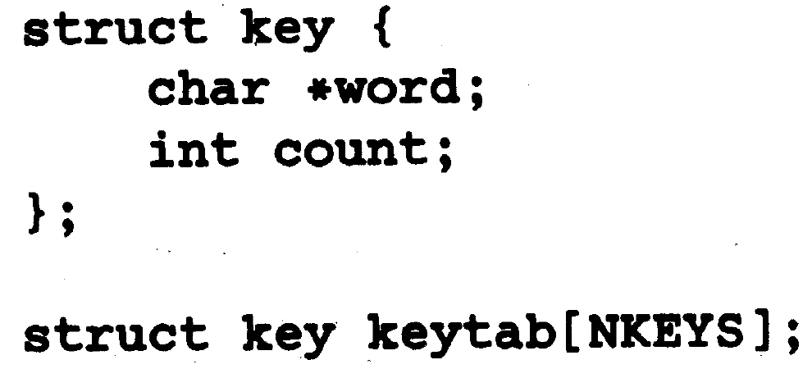
Array of Structures

Slide 16
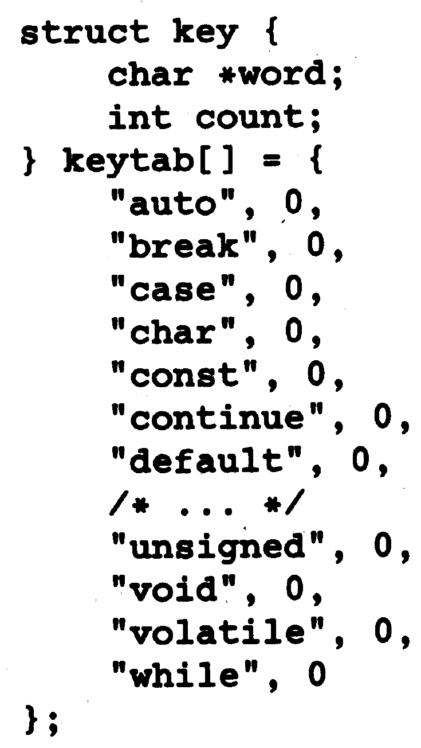
Initializing Array of Structures

Slide 17
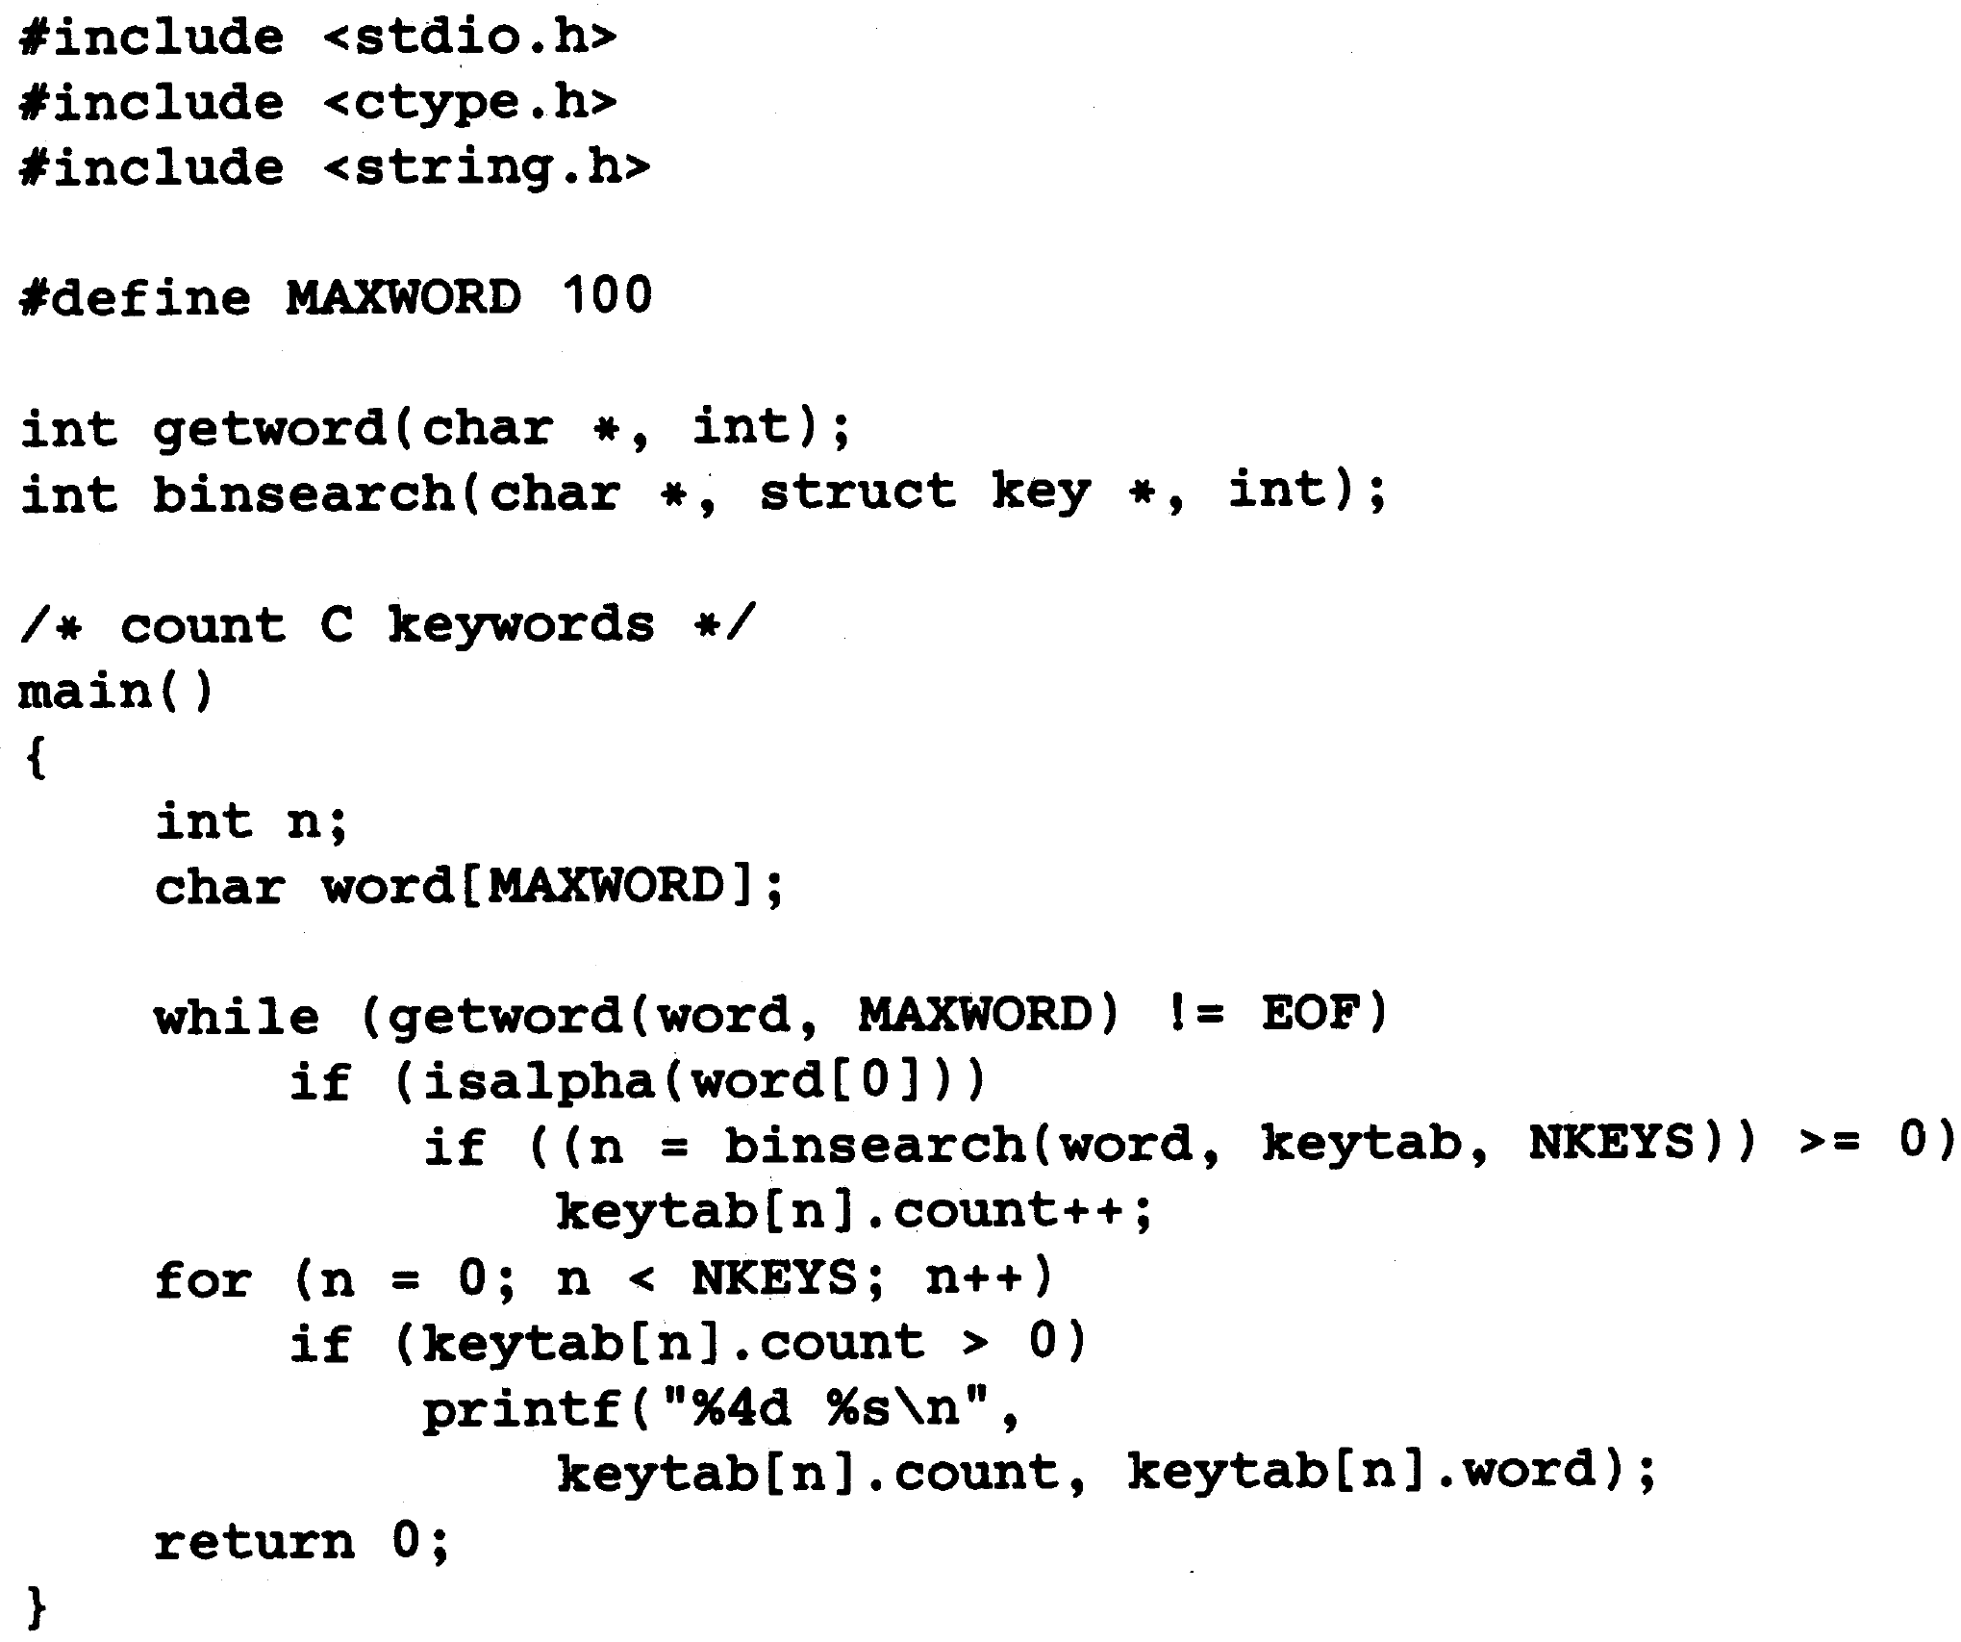
Array of Structures

Slide 18
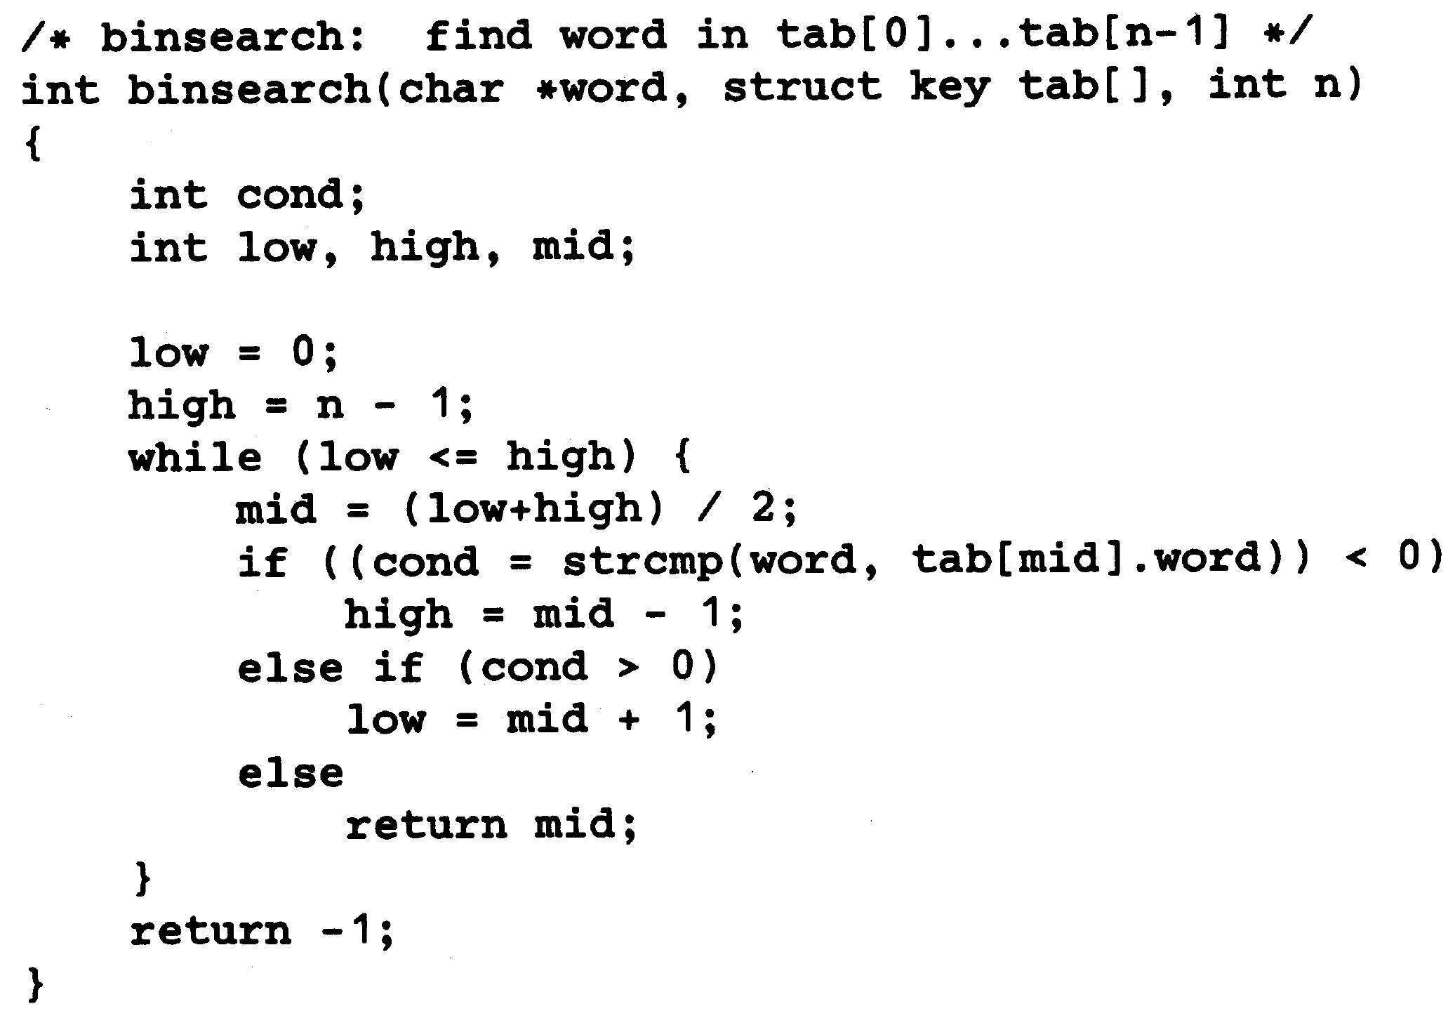
Array of Structures

Slide 19
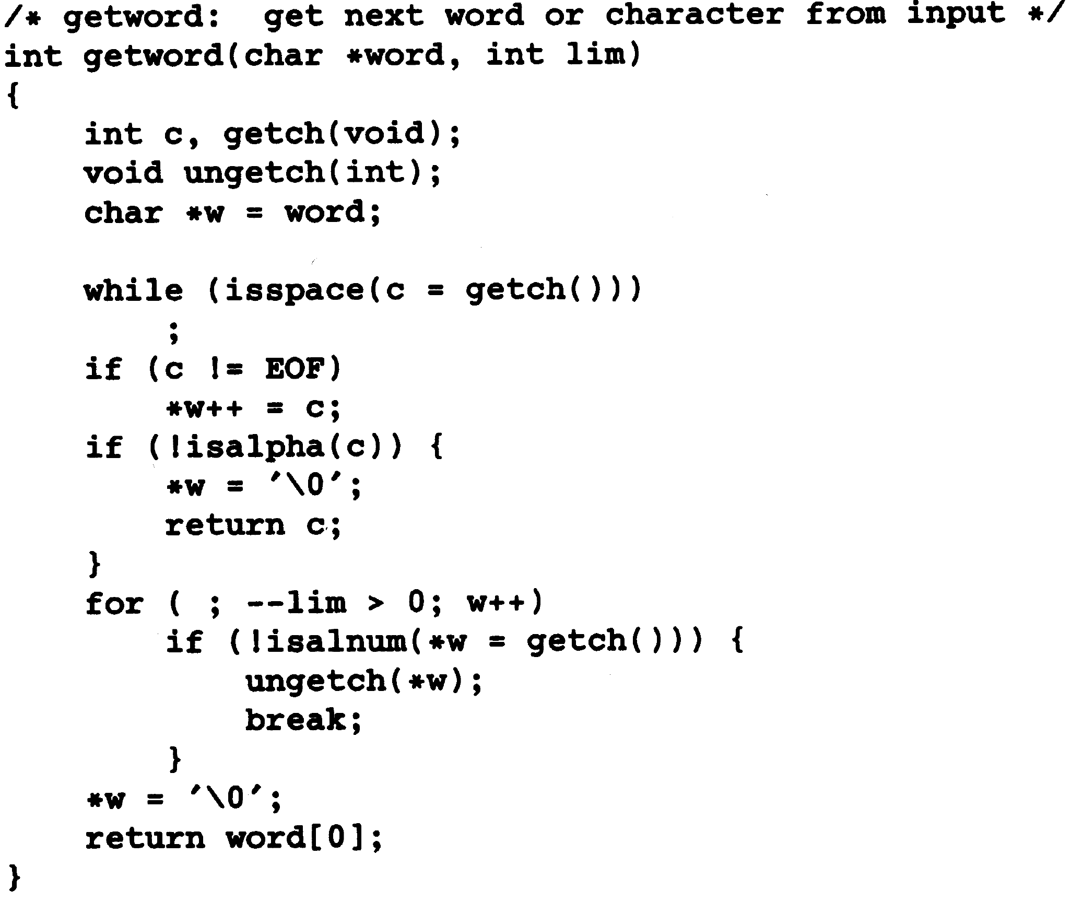
Array of Structures

Slide 20
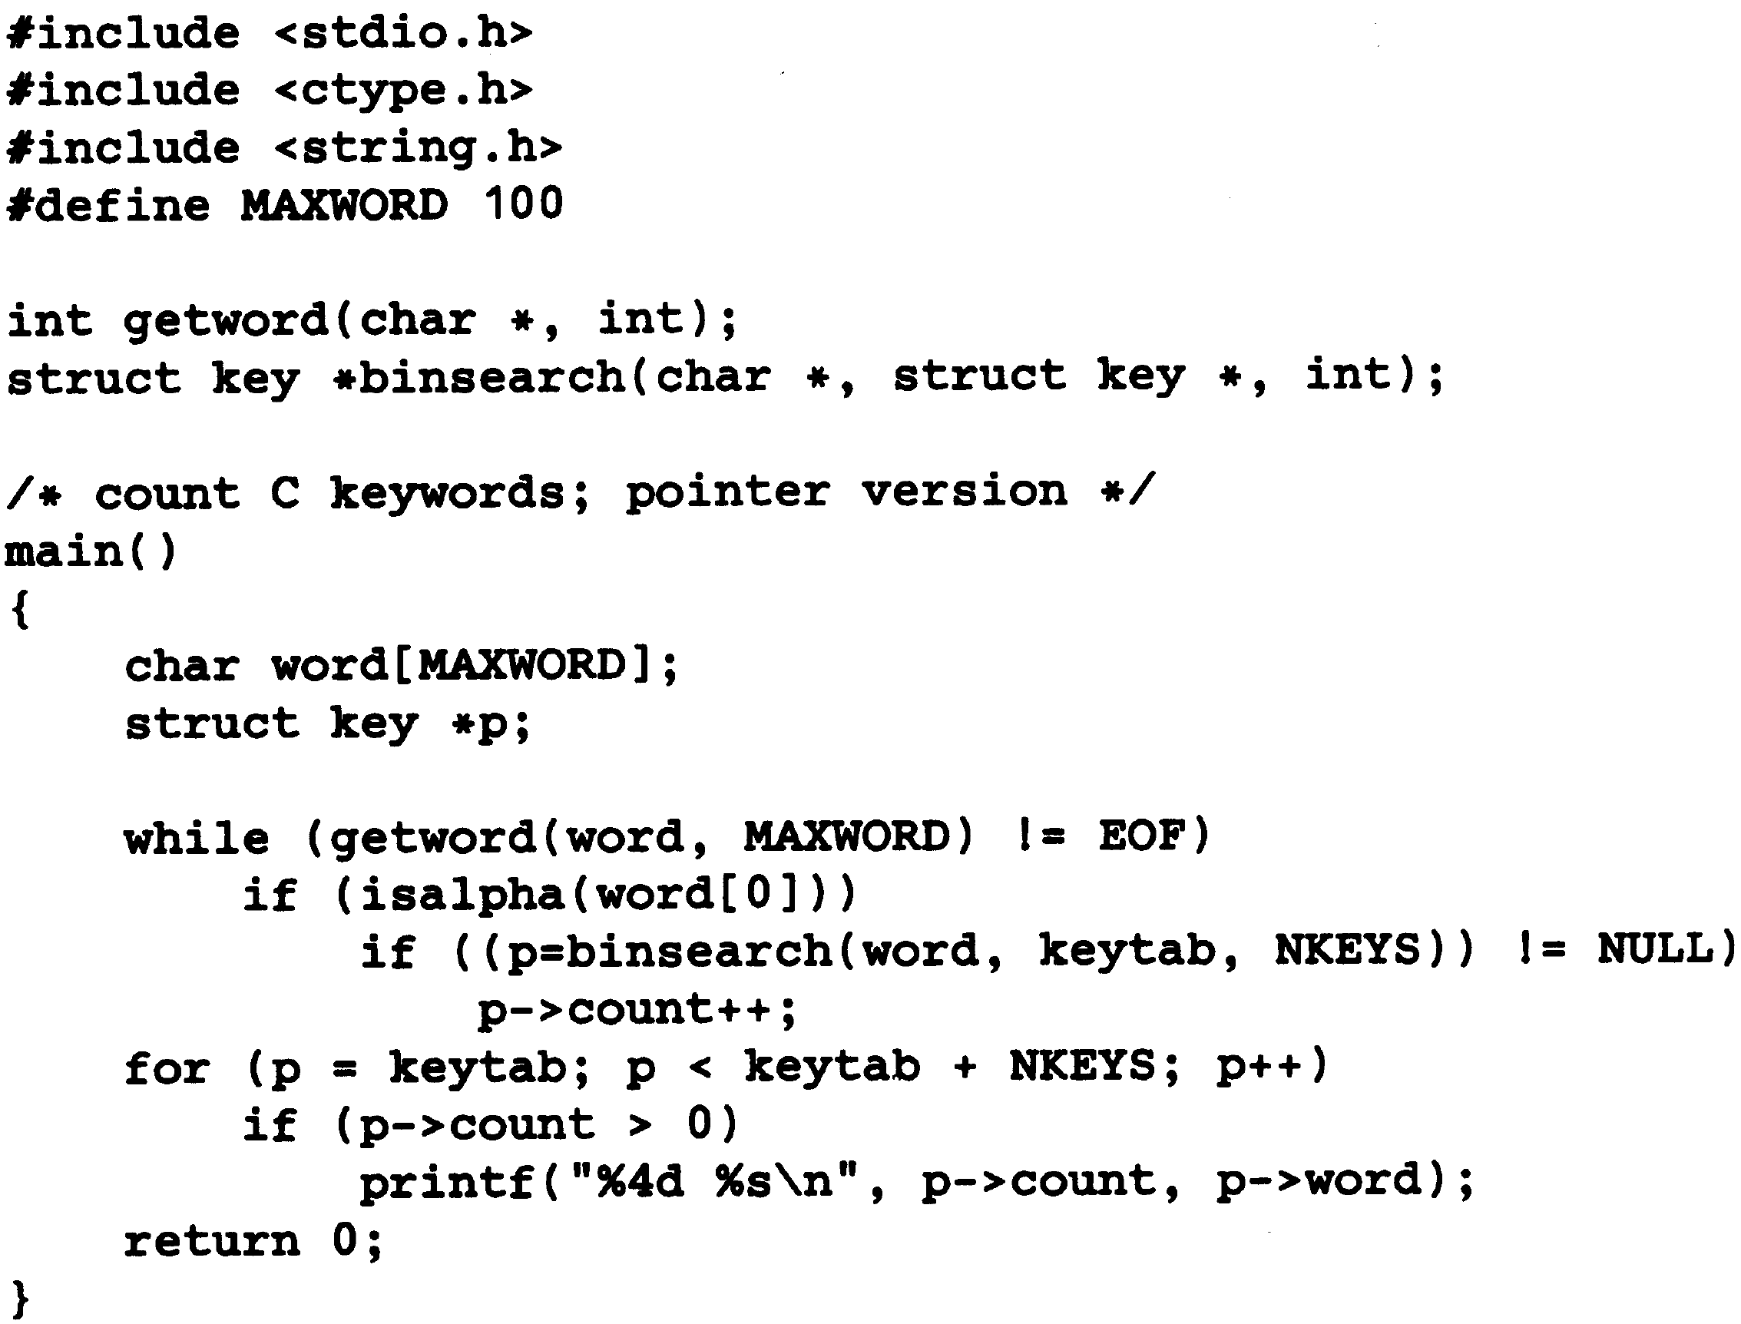
Pointers to Structures

Slide 21
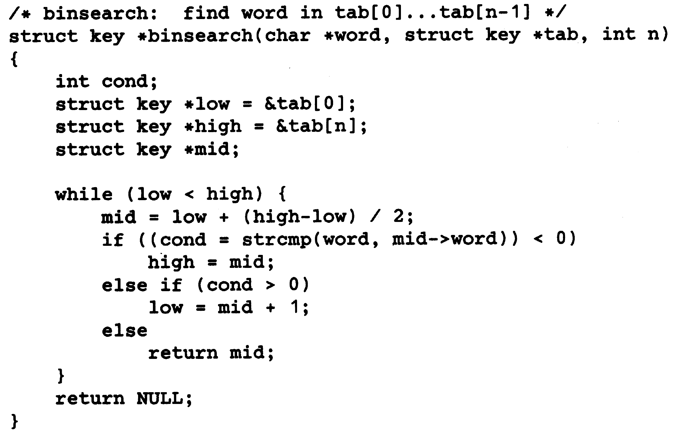
Pointers to Structures

Slide 22
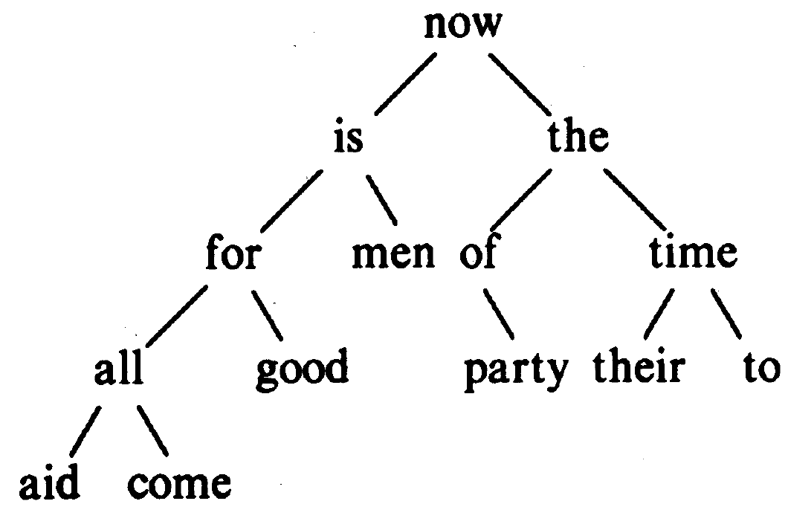
Self-Referential Structures

Slide 23
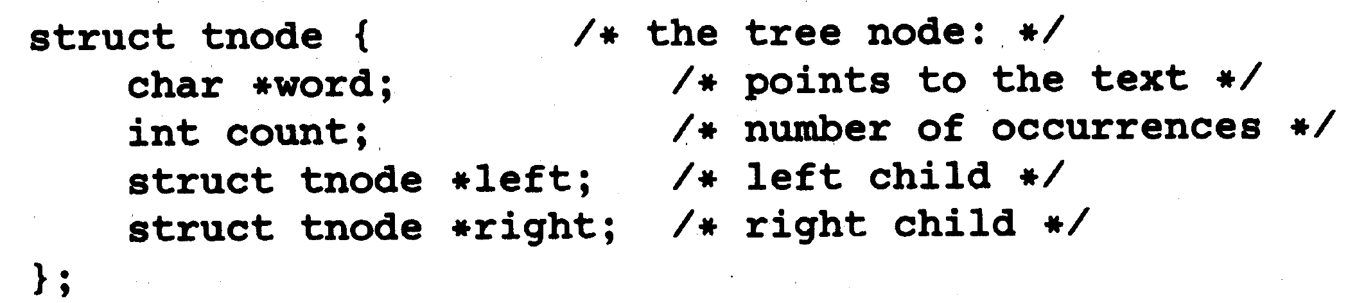
Self-Referential Structures

Slide 24
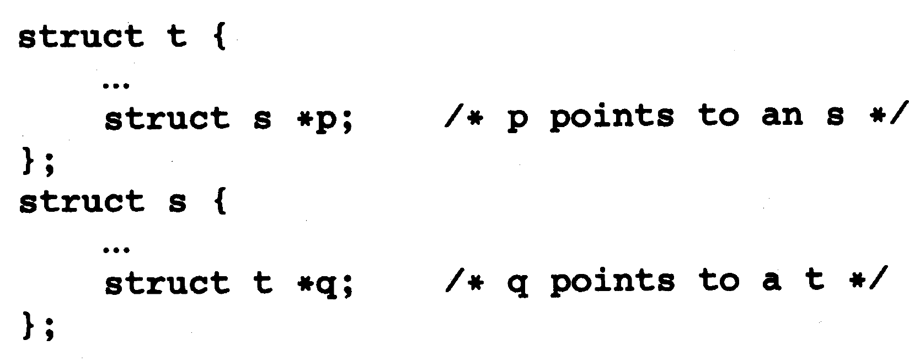
Self-Referential Structures

Slide 25
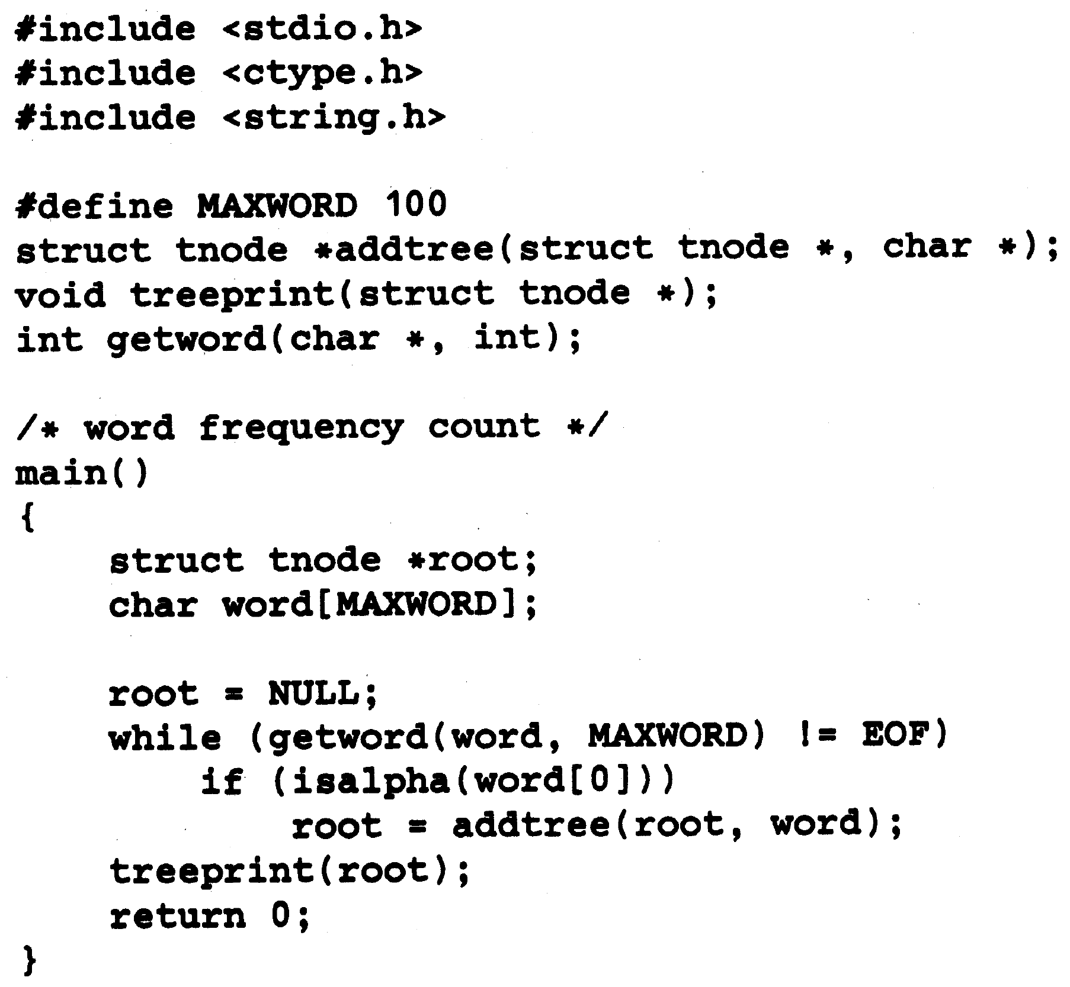
Self-Referential Structures

Slide 26
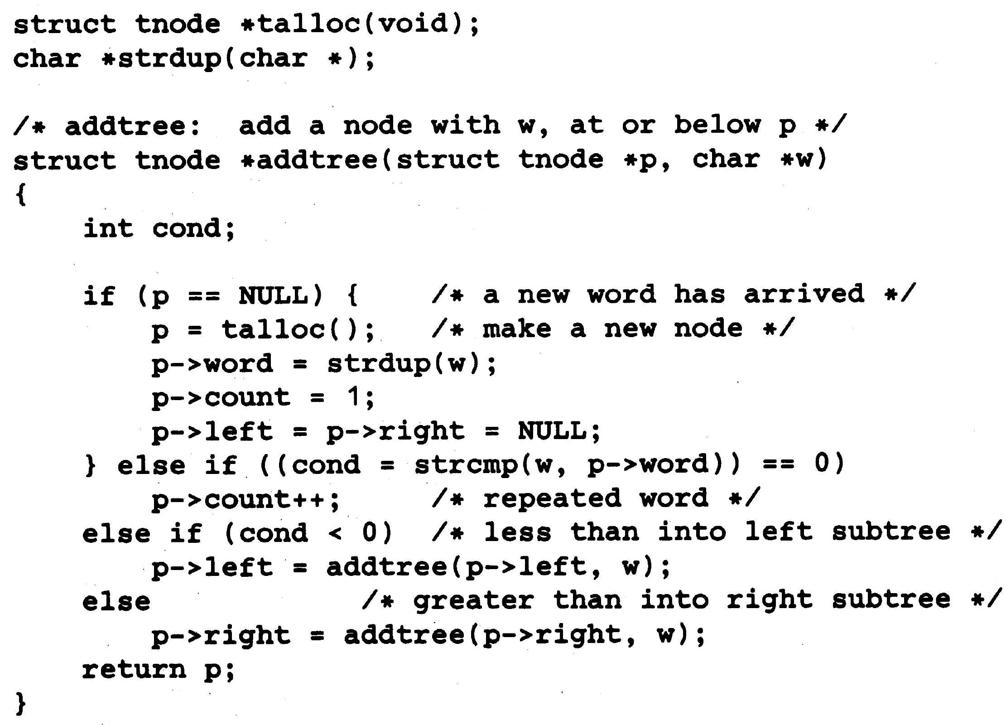
Self-Referential Structures

Slide 27
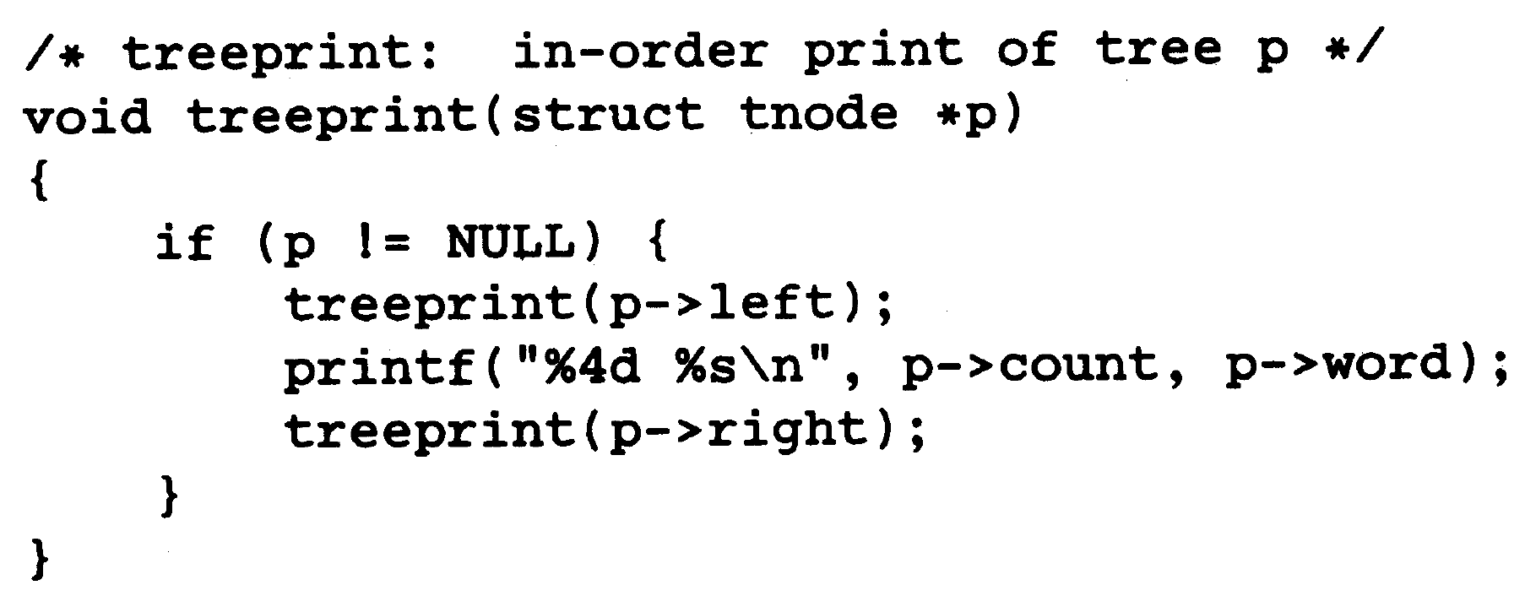
Self-Referential Structures

Slide 28
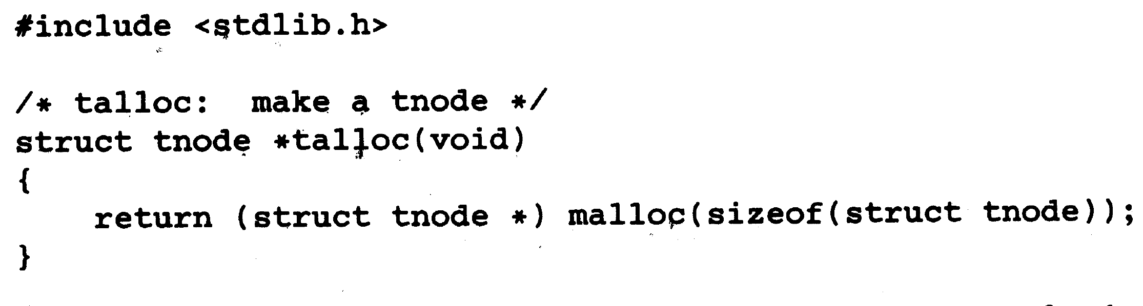
Self-Referential Structures

Slide 29
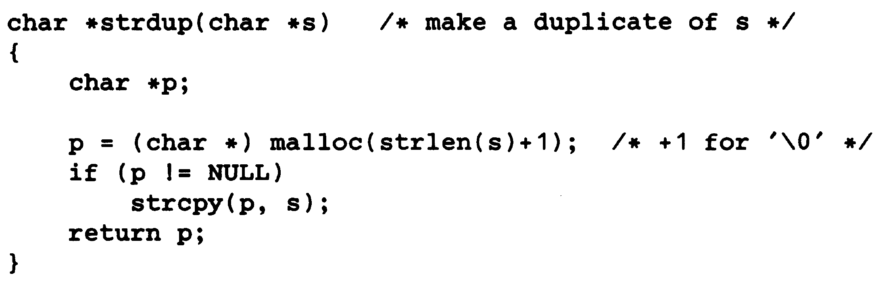
Self-Referential Structures

